Slide 1

AI
Impact of U.S. AI Policies on Tech Industry Investments
July 2024
Kehan Li
Global Growth Advisors

Slide 2
AI
INTRODUCTION

Slide 3
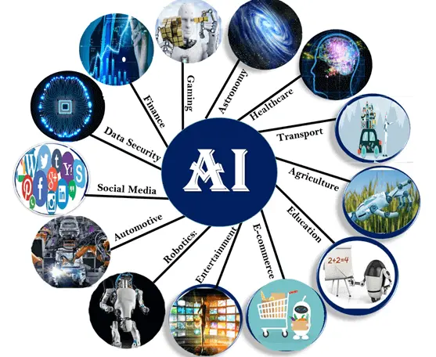
Widely applied AI
source:https://www.bbntimes.com/science/what-are-the-most-surprising-fields-that-rely-on-artificial-intelligence-and-most-people-are-generally-unaware-of

Slide 4
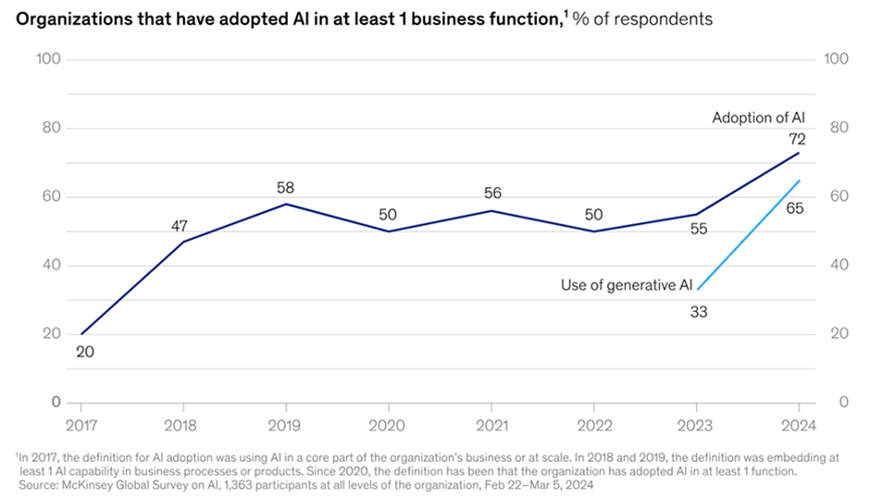

Surge in generative AI adoption from 2023 to 2024

Slide 5
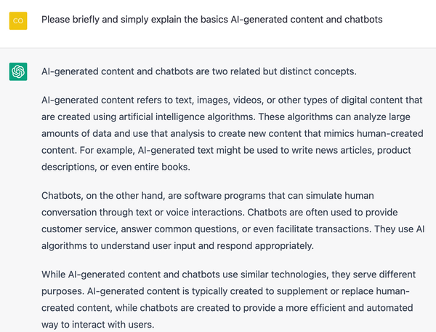

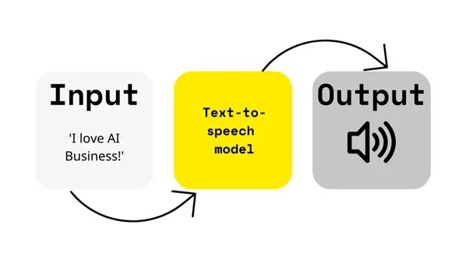
Definition of generative AI
Text
Image
Audio

Slide 6

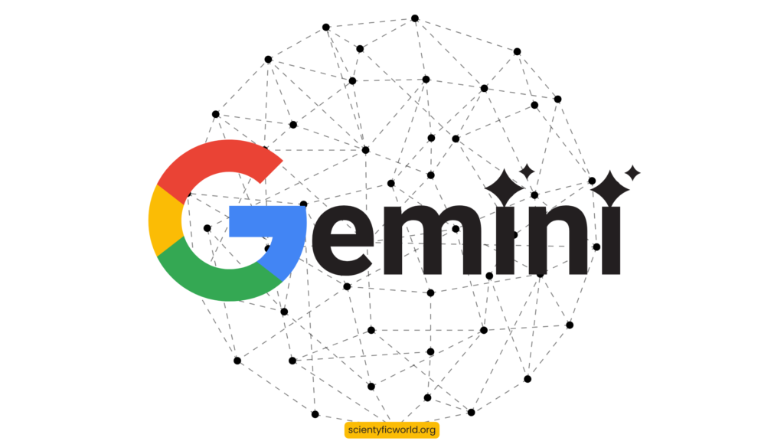
Key technologies

Slide 7
AI Investment Trends
$25.2 billion in 2023
Boost global GDP by 14% by 2030
Source:PWC
Notes:
Generative AI has experienced explosive growth over the past 18 months, with investments soaring to $25.2 billion in 2023. AI is projected to boost global GDP by up to 14% by 2030, equivalent to an additional $15.7 trillion.

Slide 8
AI
APPLICATIONS OF GENERATIVE AI

Slide 9
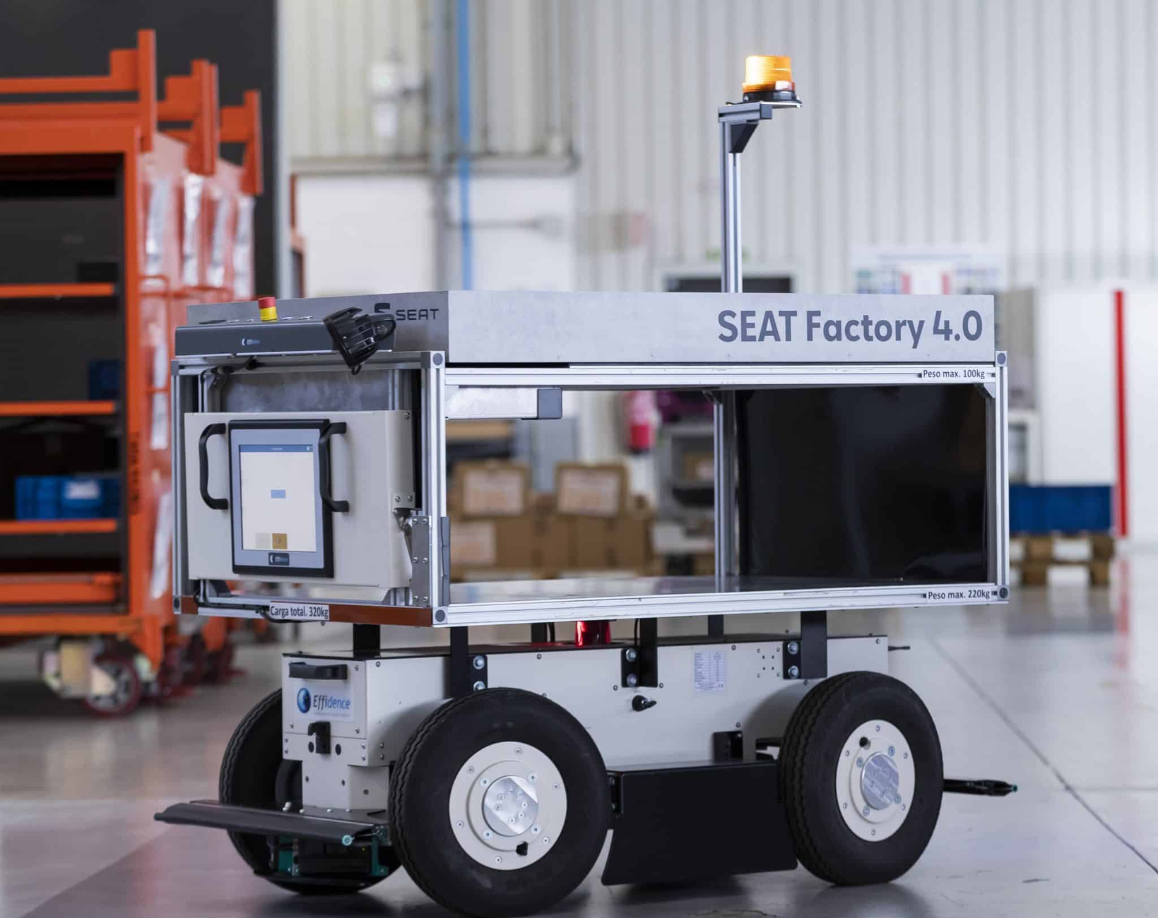
AI
Productivity Gains
Automation of routine and complex tasks
Have the potential to increase labor productivity in developed countries by up to 40% by 2035

Slide 10
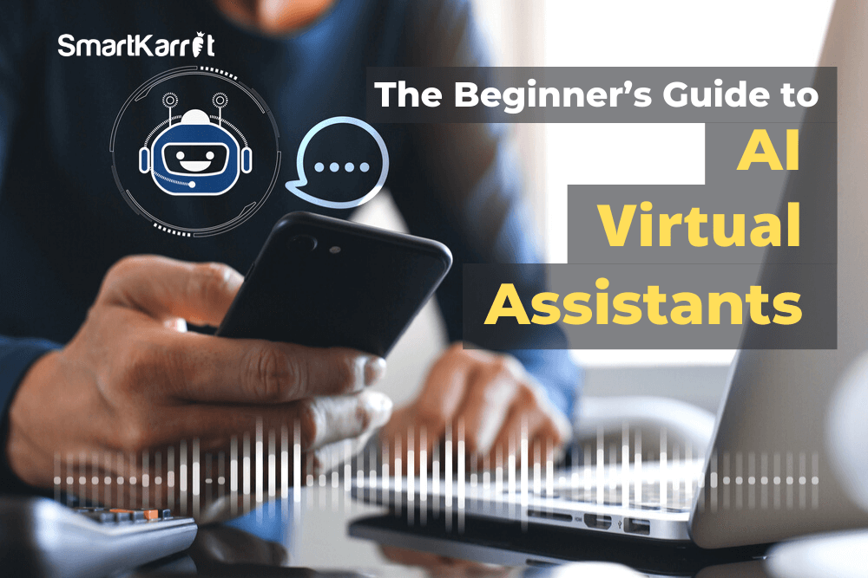
AI
Enhanced Efficiency
AI tools like virtual assistants and chatbots
Streamlining daily administrative tasks

Slide 11

AI
Improved Supply Chain
AI-driven supply chain systems
Predicting and resolving potential problems
Example: AI and data analytics for stock shortages and transportation delays

Slide 12

AI
Personalized Products and Services
Enhanced product personalization
Meeting consumer needs
Example: Frito-Lay's rapid launch of an e-commerce platform

Slide 13
AI's Strategic Importance for Tech Companies
65%
75%
Organizations are regularly using generative AI
Generative AI will lead to significant or disruptive change in their industries
Source: McKinsey

Slide 14
AI
Early adopters of generative AI are already seeing notable business gains, with some attributing over 10% of their EBIT to AI use

Slide 15
AI
U.S. AI POLICIES

Slide 16
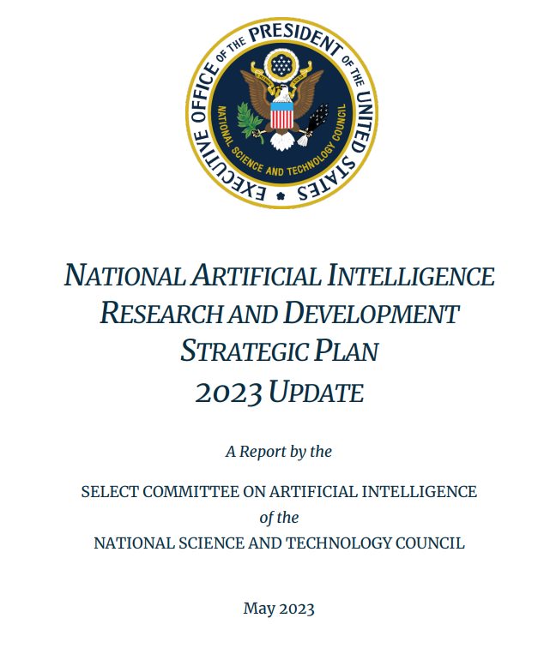

Slide 17

Long-term Investment in AI Research
Core Capabilities: Focus on AI fundamentals like perception, learning, and reasoning.
Usability and Reliability: Ensure AI technologies are user-friendly and reliable.
Risk Management: Develop strategies to manage risks associated with generative AI.
Funding: The "2022 CHIPS and Science Act" provides substantial support.
Core Insight: Ensures continuous innovation, enhancing tech companies' competitive advantage.

Slide 18

Human-AI Collaboration
Human-AI Teams: Improve understanding and efficiency of human-AI collaboration.
Team Attributes: Identify key attributes for successful collaboration.
Performance Evaluation: Create standards to measure AI efficiency in teams.
Incentives: Support R&D in human-AI collaboration technologies.
Core Insight: Focus on companies enhancing human-AI collaboration for higher efficiency and productivity gains.

Slide 19
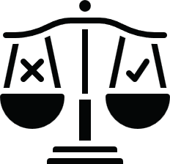
Ethical, Legal, and Societal Implications
Core Value Protection: Promote fairness and justice in AI.
Transparency and Privacy: Ensure AI systems are transparent and protect privacy.
Standards Development: Create standards for accountability and bias management.
Policy Documents: The "AI Bill of Rights Blueprint" and "AI Risk Management Framework" provide guidelines.
Core Insight: Enhances public trust and compliance with ethical standards, reducing legal risks.

Slide 20

AI System Safety and Security
System Testing and Verification: Improve testing capabilities.
Cybersecurity Protection: Safeguard AI from cybersecurity threats.
Secure Design: Integrate security throughout the AI lifecycle.
Funding: Support for safetyy standards research.
Core Insight: Ensures AI systems' reliability and security, mitigating risks.

Slide 21

Shared Public Datasets and AI Training Environments
Dataset Provision: Provide accessible public datasets for AI research.
Computational Resources: Offer high-performance computing resources.
Funding: Support through the "National AI Research Resource Task Force".
Government Open Data Policies: Promote open data sharing.
Core Insight: Facilitates AI innovation by providing necessary data and resources.

Slide 22

Measuring and Evaluating AI Systems
Evaluation Techniques: Develop standards for AI performance evaluation.
Management Frameworks: Align methods with the "AI Bill of Rights Blueprint".
Incentives: Encourage community engagement in standards development.
Core Insight: Ensures consistent and measurable AI performance.

Slide 23

Understanding National AI R&D Workforce Needs
Workforce Development: Study and prepare for AI role demands.
Education Enhancement: Improve AI education and training.
Funding: Support educational programs.
Core Insight: Ensures a skilled workforce to meet future AI needs.

Slide 24

Expanding Public-Private Partnerships
Sustained Investment: Promote continuous AI R&D investment.
Broad Partnerships: Establish collaborations across sectors.
Incentives: Provide tax incentives and R&D grants.
Core Insight: Accelerates AI application and impact through collaboration.

Slide 25

Coordinated International AI Research Collaboration
Global Challenges: Collaborate on global issues like sustainability.
Standards Development: Promote global AI standards.
Support for Cooperative Projects: Encourage international projects.
Core Insight: Facilitates global AI R&D, promoting technology sharing and cooperation.

Slide 26
The policy emphasizes continuous innovation, ethical standards, and collaboration to drive AI development and ensure its safe, responsible, and widespread application.

Slide 27
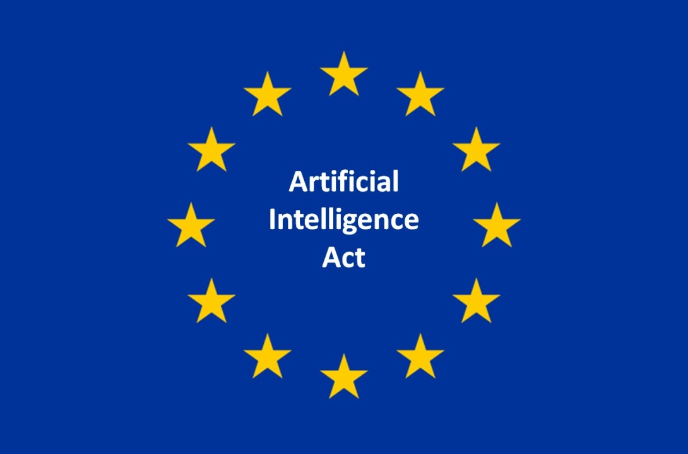
The EU AI Act adopts a risk-based classification system, enforcing binding rules with significant penalties for noncompliance, and mandates transparency and impact assessments.

Slide 28


AI
Policy Differences
U.S. policies promote innovation and ethical standards through flexible guidelines and collaboration.
The EU AI Act enforces strict, risk-based regulations with significant penalties

Slide 29
AI
PROBLEMS WITH AI

Slide 30
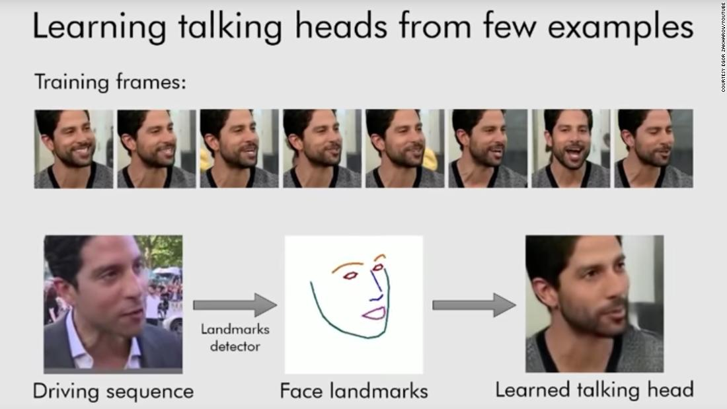
Disinformation
AI-generated disinformation, including deepfakes, is a growing issue.
Realistic fake images, videos, and audio can manipulate public opinion.
Significant impact during elections and other critical events.

Slide 31
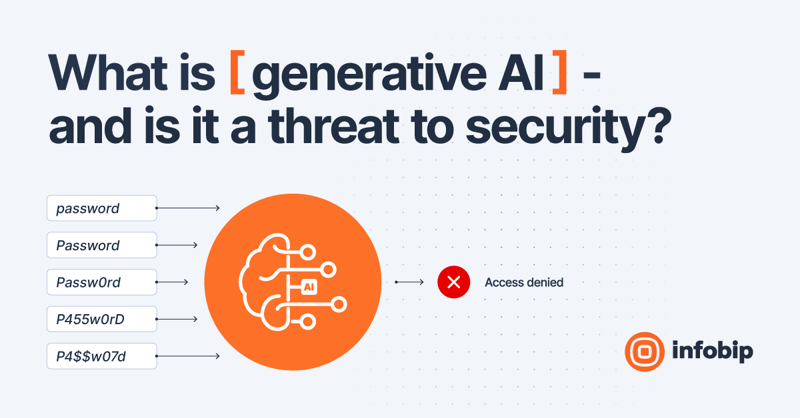
Security and Ethics
AI models are prone to hacking and misuse.
Privacy and security.
Ongoing concerns about the responsible use of AI-generated content.

Slide 32
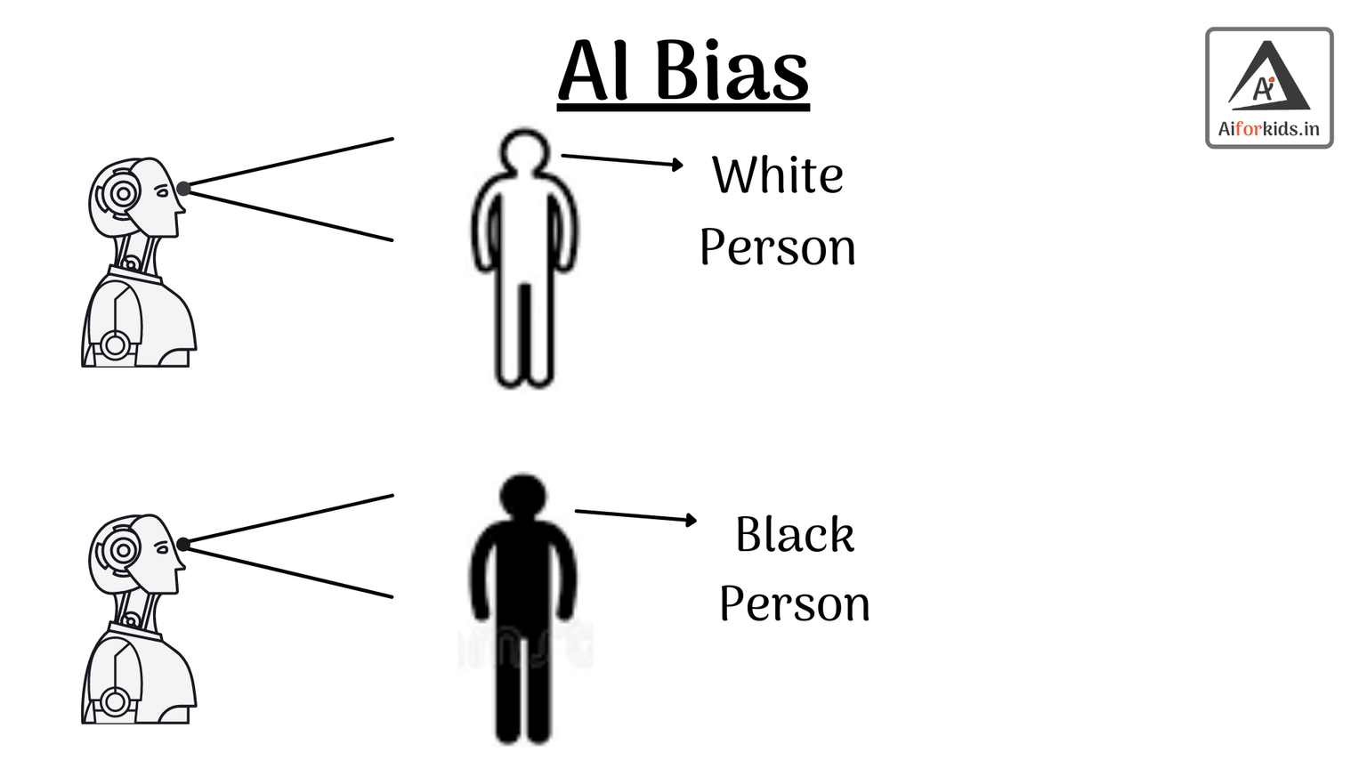
Bias and Reliability
AI models like GPT-4 and Google's Gemini often produce biased outputs.
Unreliability in these models can pose significant challenges.
The importance of developing fair and accurate AI systems.

Slide 33
AI
IMPLEMENTATION CHALLENGES

Slide 34

Red Queen problem
“Regulators struggle to keep up with the fast pace of AI advancements.”

Slide 35
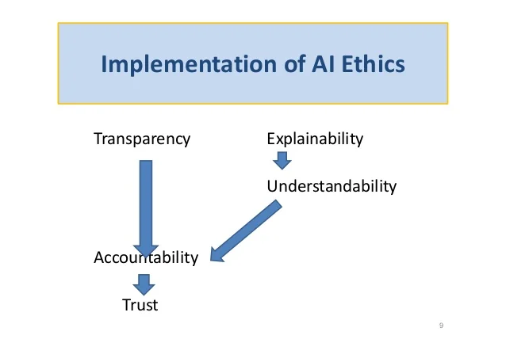
Transparency and Accountability
Importance of transparency in AI development and deployment.
Policies like the EU’s AI Act mandate rigorous documentation and audits.
Challenges for companies to comply with transparency requirements.
Potential consequences of non-compliance, such as significant fines.

Slide 36

Lack of AI Regulatory Agency
The U.S. currently lacks a specific agency dedicated to AI regulation.
Proposals for a federal AI oversight agency supported by industry leaders like OpenAI, Microsoft, and Meta.
The need for a flexible, risk-based regulatory approach.
Comparison with the EU, which has established institutions for AI regulation.

Slide 37
AI
DIAGONAL ANALYSIS

Slide 38
Strengths:
Weaknesses:
Comprehensive framework addressing data privacy, ethical use
Focus on innovation and workforce development
International collaboration
Implementation challenges
Balancing innovation and regulation
Economic displacement

Slide 39
Opportunities:
Threats:
Enhancing global competitiveness
Improving public trust and adoption of AI technologies
Addressing significant societal challenges
Technological and ethical risks
Global regulatory landscape
Economic inequality

Slide 40
AI
AI POLICY AND GEOPOLITICS

Slide 41
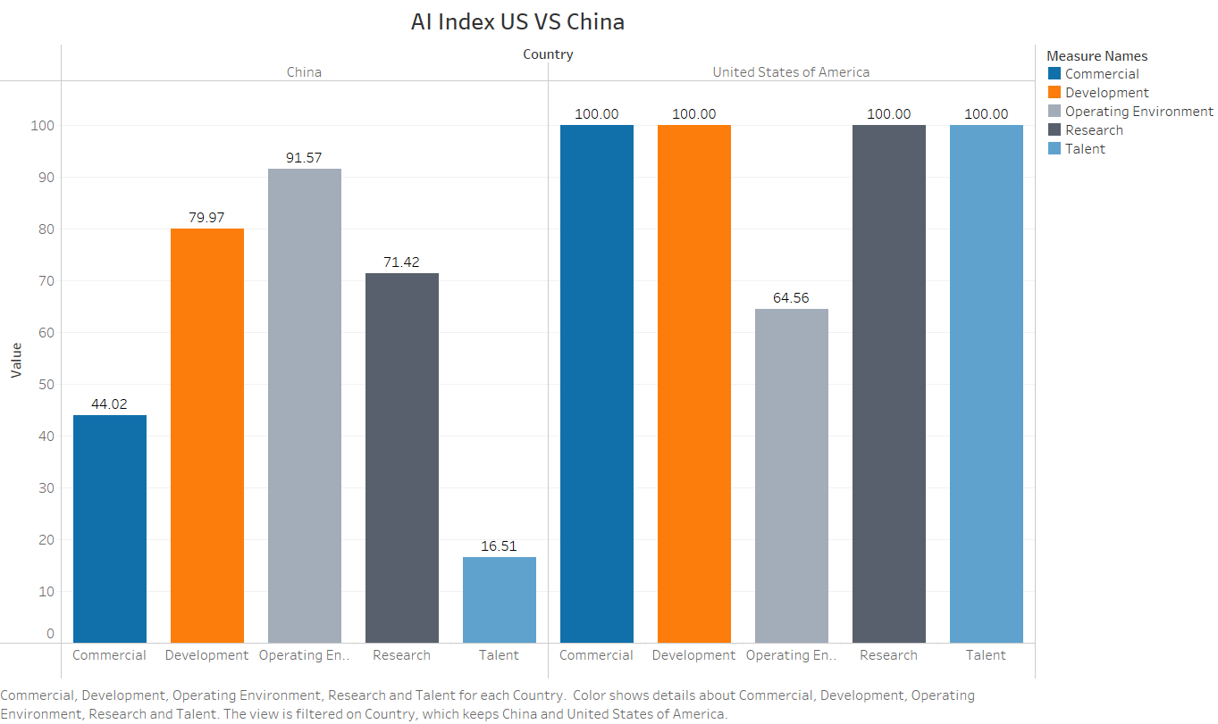
U.S.-China AI rivalry

Slide 42
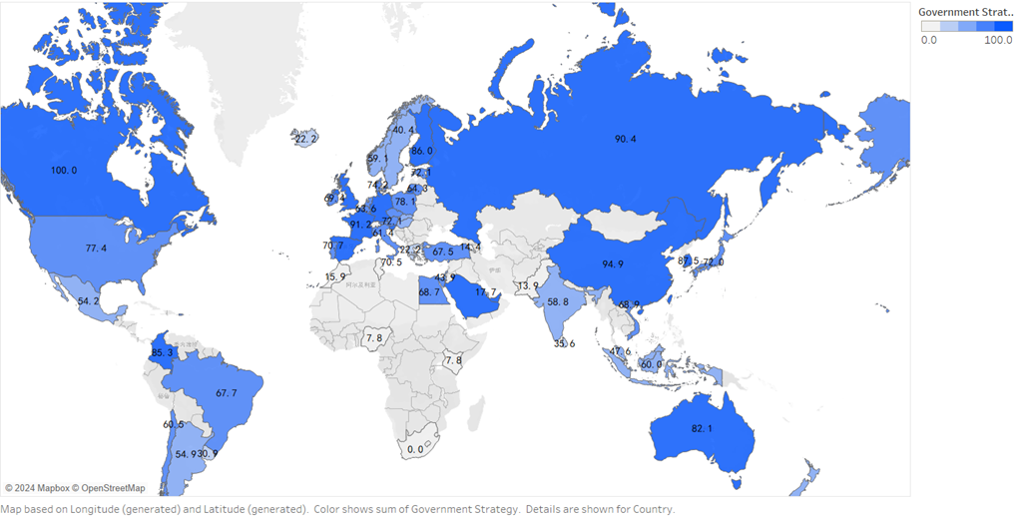
Government Strategy Distribution
*Government Strategy is the factor of Investment group of indicators, which reflects financial and procedural commitments to artificial intelligence.Data source: AI Global Index

Slide 43
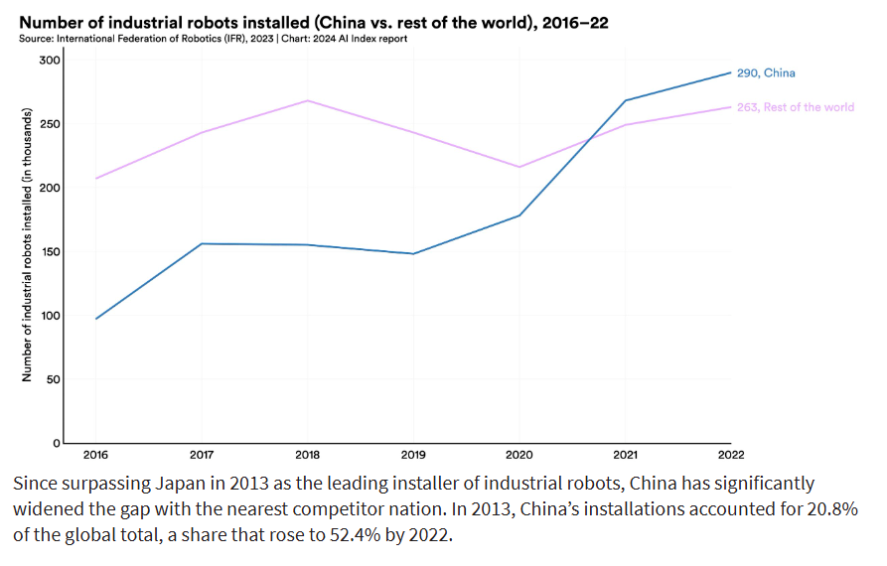
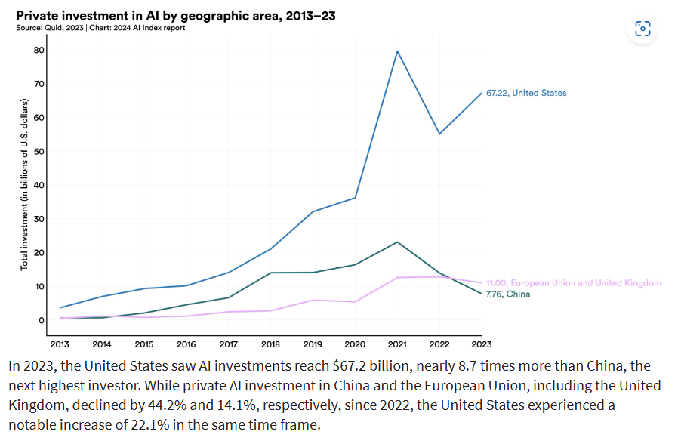
The competition between the U.S. and China in AI technology is intense.

Slide 44
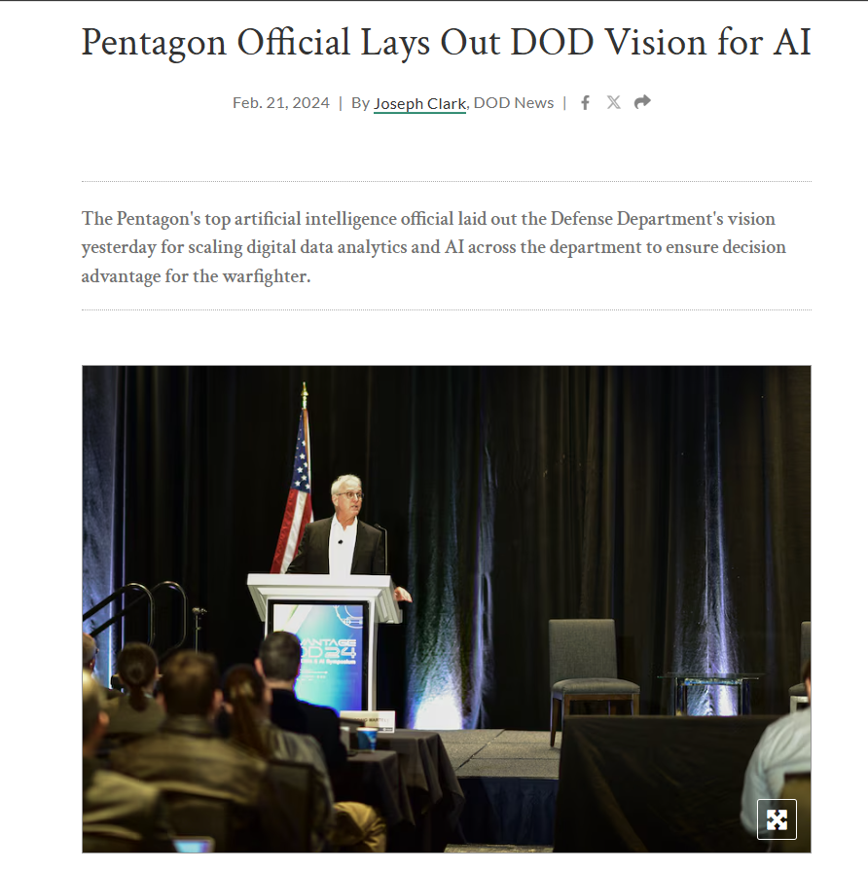
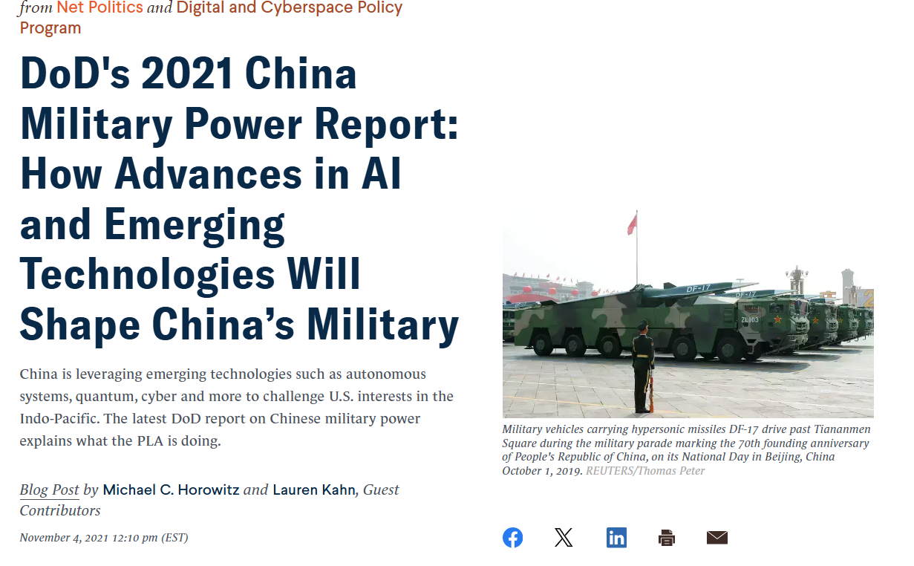
This rivalry poses strategic risks, including technological dominance, espionage, and military confrontations, as both countries heavily invest in AI R&D for global leadership.

Slide 45
China's AI strategy involves significant state-led investments and integration of AI into military applications, while the U.S. focuses on innovation-driven approaches supported by private sector initiatives.

Slide 46
Recommendations

Slide 47
Support Key Industry Players
Increase Funding and Incentives: Provide more grants and subsidies to companies leading in AI research and development, including established tech giants and innovative startups.
The National Science Foundation (NSF) can increase funding for AI research, and initiatives like the Defense Advanced Research Projects Agency (DARPA) can continue supporting AI innovation in defense technologies.

Slide 48
Develop Regulatory Framework
Establish a Federal AI Agency: Create a dedicated agency to oversee AI developments and ensure compliance with ethical standards and regulations.
Legislation: Develop and pass comprehensive AI regulations that balance innovation with public safety and ethical considerations. This could include updating existing laws to address AI-specific challenges.
The AI in Government Act aims to enhance the use of AI in federal agencies and ensure responsible development and deployment.

Slide 49
Foster Collaboration
Government-Private Sector Partnerships: Encourage partnerships between federal agencies and private tech companies to accelerate AI development and application.
Academic Collaboration: Promote collaboration between universities and industry to drive cutting-edge research and practical applications.
The AI Research Institutes initiative supports academic, industry, and government collaboration.

Slide 50
Implement Economic Policies
Tax Incentives and Subsidies: Provide tax breaks and subsidies for companies investing in AI research and development. This will stimulate more investment in the sector.
Funding for Startups: Establish funds specifically for AI startups to help them scale and innovate.
The Research & Experimentation Tax Credit can include more AI projects.

Slide 51
Focus on Transparency and Accountability
Mandate Transparent AI Systems: Companies must disclose AI system operations, decision-making processes, and data usage. This transparency will build public trust and ensure accountability.
Standards for AI Ethics: Develop and enforce ethical standards for AI development and deployment, ensuring systems are fair and unbiased.
The Algorithmic Accountability Act proposes requirements for assessing the impact of automated decision systems and ensuring transparency.

Slide 52
Address Social and Ethical Concerns
Regulations on Privacy and Bias: Implement regulations to protect user privacy and prevent biases in AI systems. This included strict guidelines on data usage and algorithmic fairness.
Public Awareness Campaigns: Educate the public on the benefits and risks of AI to promote informed use and acceptance of AI technologies.
The European Union’s General Data Protection Regulation (GDPR) can serve as a model for U.S. privacy regulations.

Slide 53
AI
In conclusion, U.S. AI policies significantly impact tech industry investments. Balancing innovation with regulation is essential to fostering a robust AI ecosystem.

Slide 54

THANKS

